Slide 1


Mobile Programming Course Fall 2021 Mohamad ChamanMotlagh Amirhosseir Hedielou Moein NasrKhademli Course lecturer: Dr. Sajad Shirali-Shahreza CE Department, Amirkabir University of Technology
3D illustrator
MVP Preview

Slide 2
TABLE OF CONTENTS
1.
2.
3.
Motive & Purpose
Remebring the main idea
Implemented Sections
What has been done so far
Demo
A short demo of our work

Slide 3
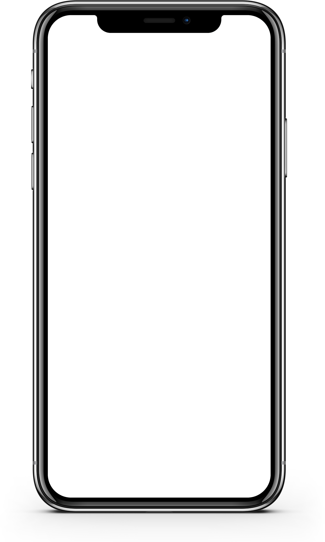
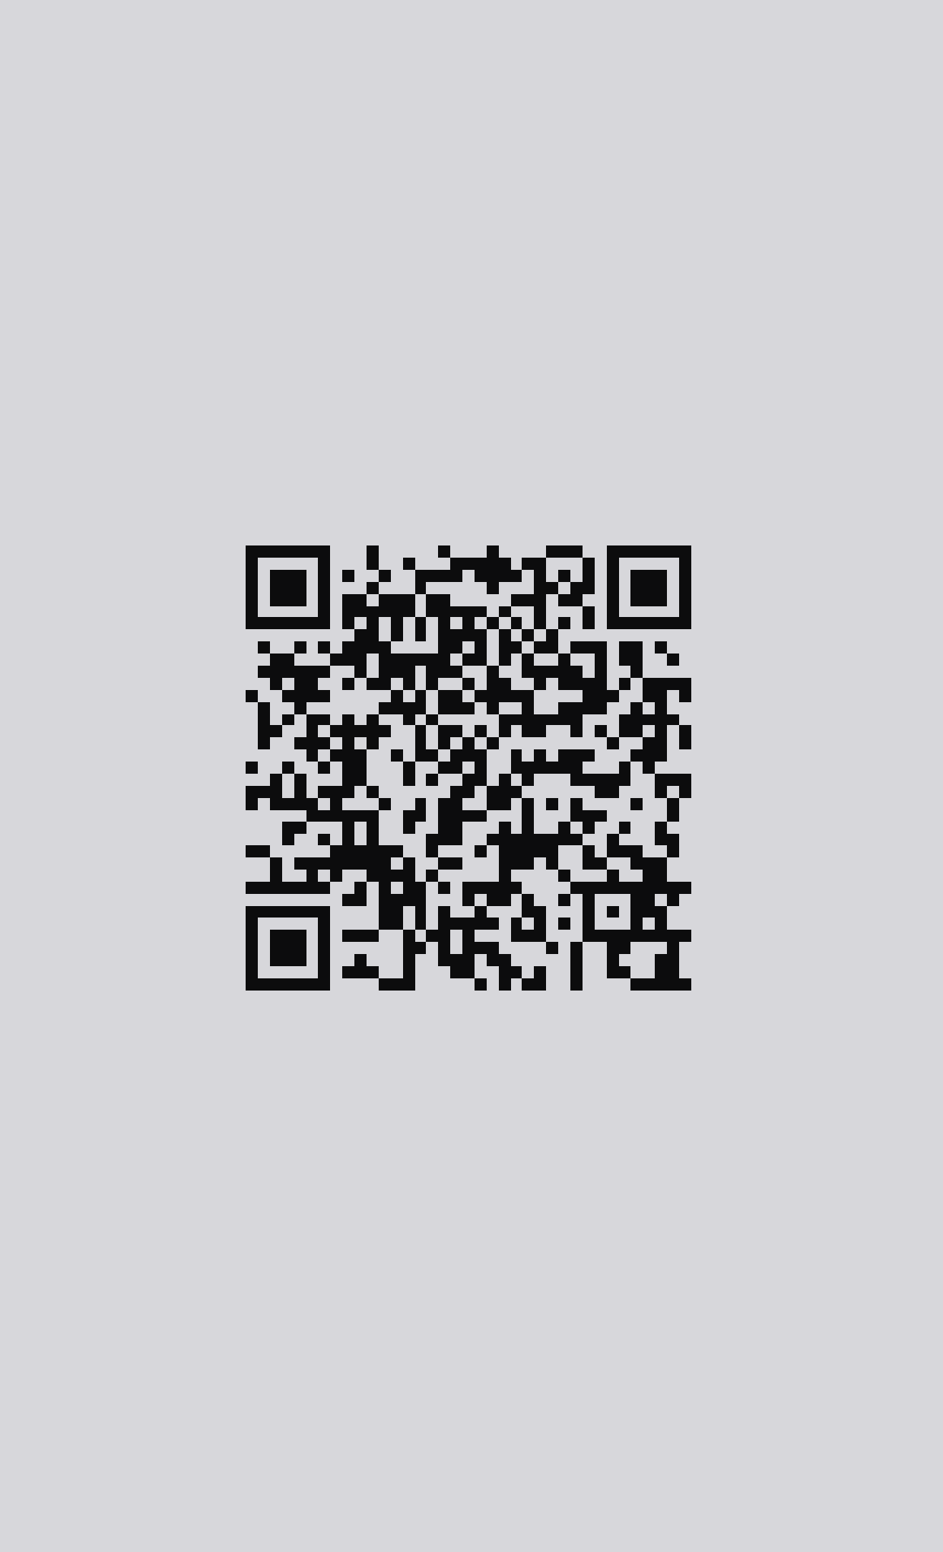

Simplified Workflow
Authentication
Search
Process and Send

Slide 4
First Preview Implemented Sections
Overall flow of the Application
First page of the app
QR scanner Activity
Model Viewer Activity
Structure
Coloring and Styles
Dark/Light mode
Activity change
Structure
Functionality

Slide 5
First Preview Implemented Sections
MVP Implemented Sections
Login/Register Logic
Visual Activities
Model Viewer Logic
Overall flow of the Application
First page of the app
QR scanner Activity
Model Viewer Activity
Request/Response
Error Checking
Structure
Coloring and Styles
Dark/Light mode
Activity change
Better UI/UX
Animations
Structure
Functionality
Show 3D Models
Show AR Models
Interactivity

Slide 6
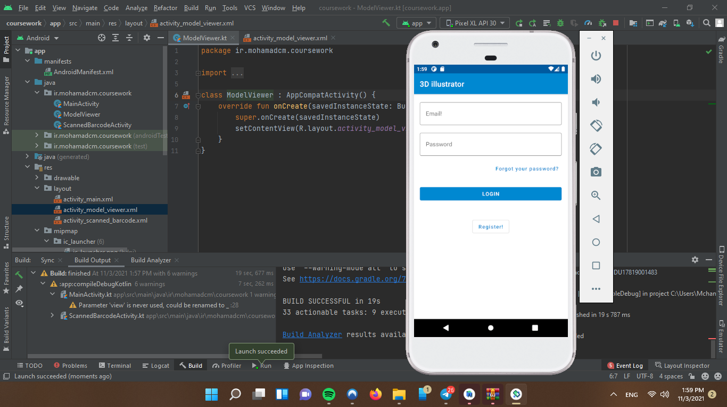
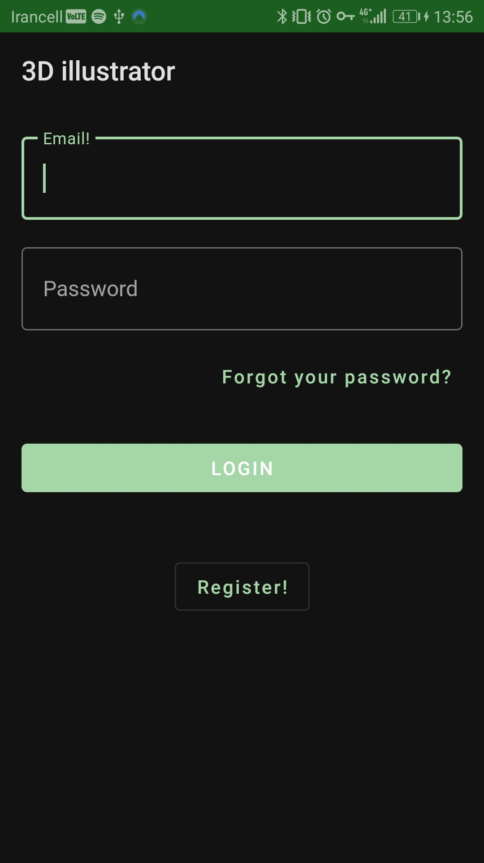
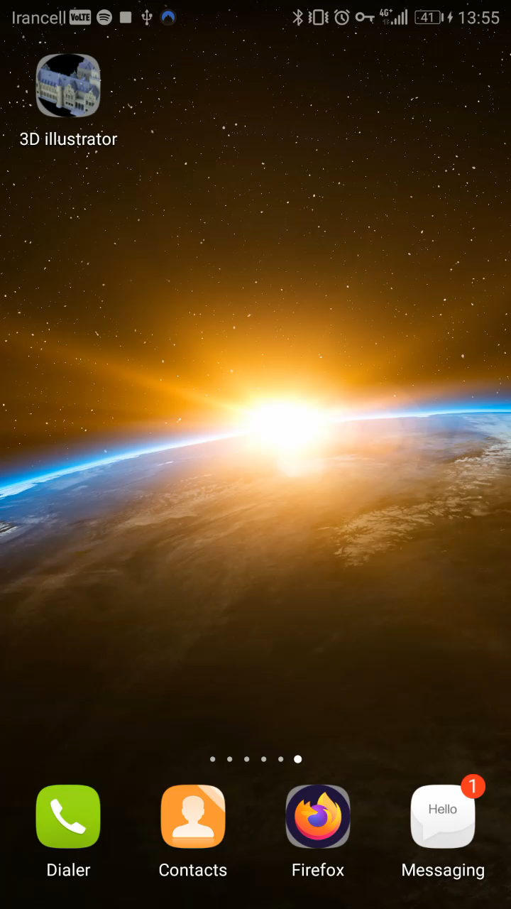
First Preview Demo

Slide 7
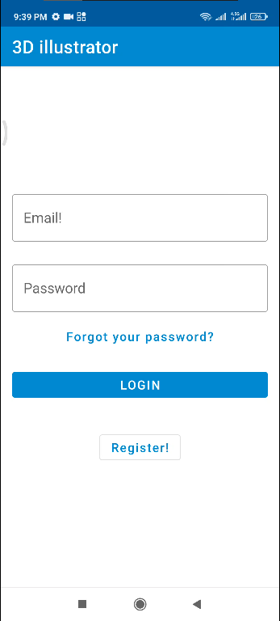
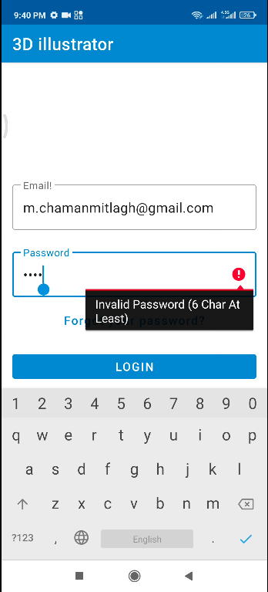
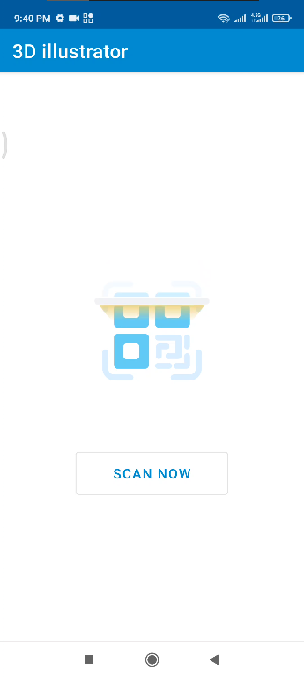
MVP Flow

Slide 8
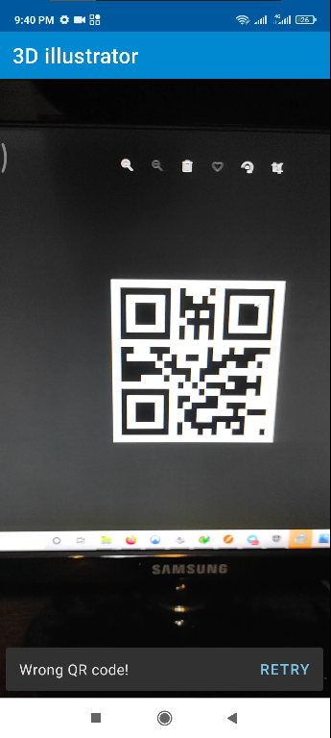
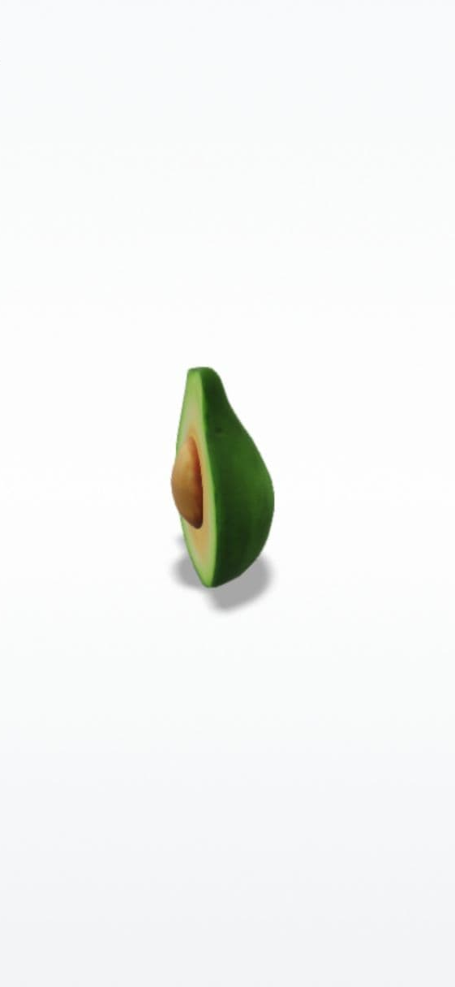
MVP Flow

Slide 9
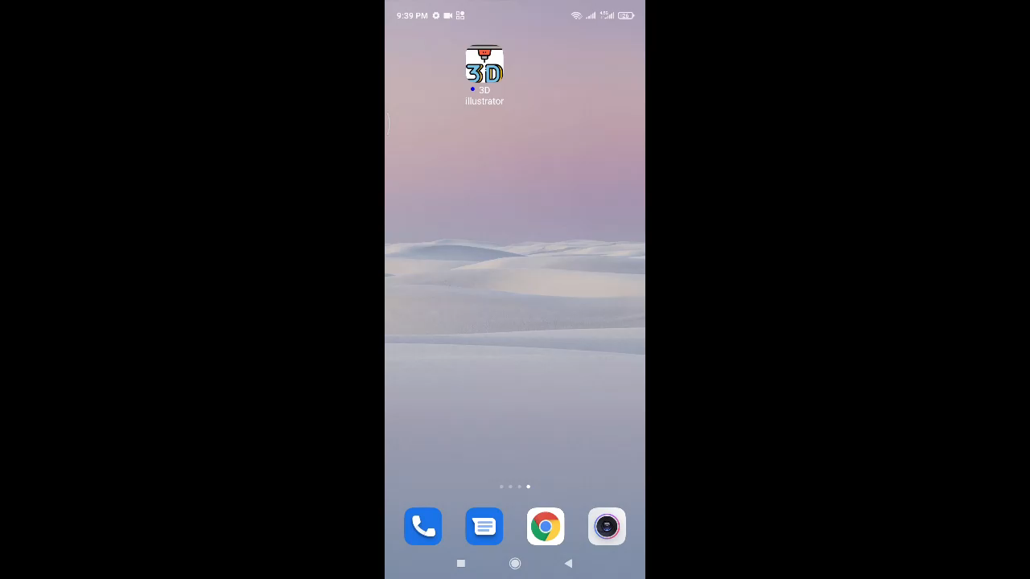
MVP Demo

Slide 10
THANKS!
DO YOU HAVE ANY QUESTION?

